Slide 1
Learning machine
Briefing

Slide 2
Main purpose
Question – Answer play
Easy to add new questions
Using Leitner_system to improve the user learning

Slide 3
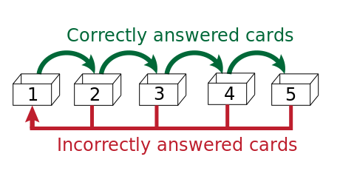
Algorithm

Slide 4
How to choose the available questions?
All the questions in the box 1 are included
All the questions in the box 2 are included if the last answer is correctly before 1 minute
All the questions in the box 3 are included if the last answer is correctly before 3 minutes
All the questions in the box 4 are included if the last answer is correctly before 5 minutes

Slide 5
Example
Question | Box | Updated
1 | 1 | 10 seconds
2 | 1 | 15 seconds
3 | 1 | 10 minutes
4 | 1 | 2 hours
5 | 1 | 10 days
6 | 2 | 30 seconds
7 | 2 | 2 minutes
8 | 3 | 4 minutes
9 | 4 | 4 minutes
10 | 4 | 1 hour
Questions available:
1,2,3,4,5 because are in box 1
6 because is in box 2 and < 1 minute
9 because is in box 4 and < 5 minute
The plattform randomly chooses a question among all available questions

Slide 6
Functionalities
Create user
Delete user
Create question
Update question
Delete question
Get question
Play (get question from available questions)
Send answer

